Slide 1








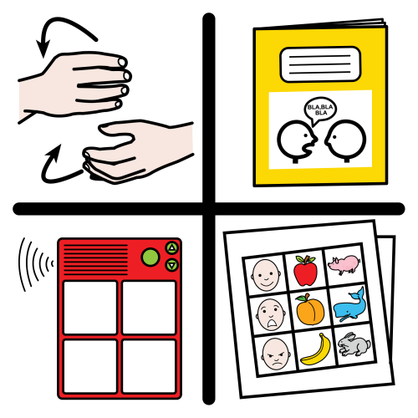
































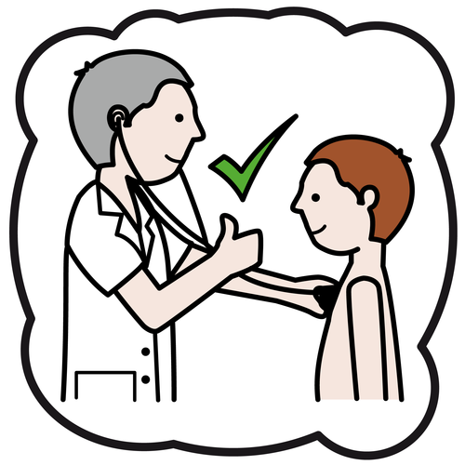










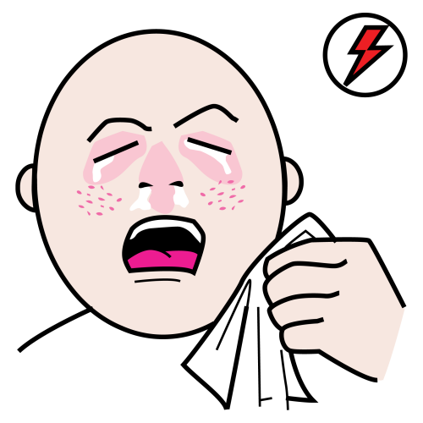










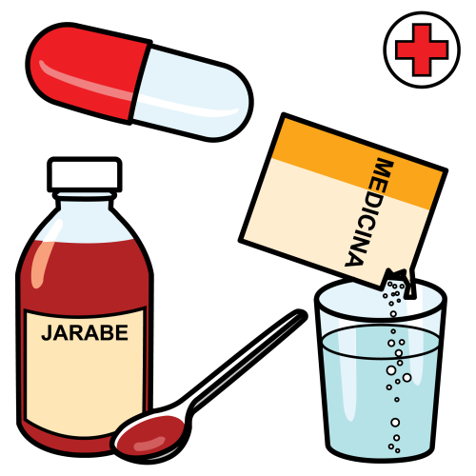





























My name is
I live in
My favourite thing….
Hello
bye
How I communicate….
My birthday is on the
Things I like
You can help me communicate by…..
My phone number is
I do not like
Emergency contact
My doctor:
Emergency contact:
Emergency contact:
Email:
Pain Scale
Ask me a yes/no question.
1 2 3 4 5 6 7 8 9 10
You’re way off
almost
You got it!
Dull pain
sick
chest pain
dizzy
Strong pain
It’s about
animals
Body
health
clothes
fever
diarrhea
constipation
headache
earache
nature
/earth
transport
sport/
leisure
at home
weather
Medical info
Existing conditions:
Allergies:
Medication:
Other info:
happy
sad
hot
cold
tired
phone
television
bag
battery
things
good
bad
confused
worried
scared
charger
book
camera
photo
fire
ill
angry
embarrassed
different
same
internet
computer
passport
money
emergency
Q
W
E
R
T
Y
U
I
O
P
yes
I’m fine
ok
I’m don’t feel well
No/not
A
S
D
F
G
H
J
K
L
space
I’m lost
I don’t know
I don’t understand
Can’t find what I need to say
don’t
Z
X
C
V
B
N
M
.
mistake
I’ll spell it
I’m sorry
please
Thank you
excuse me
I want
to talk

Slide 2












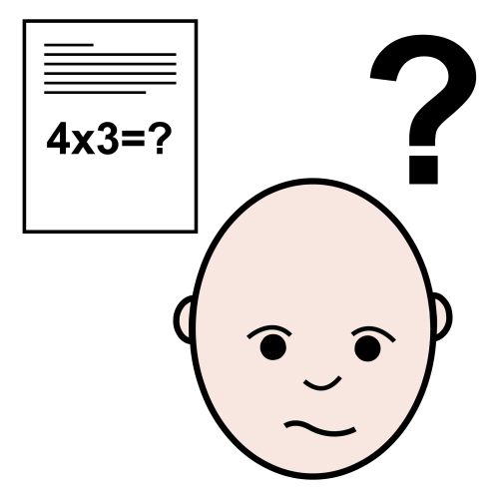











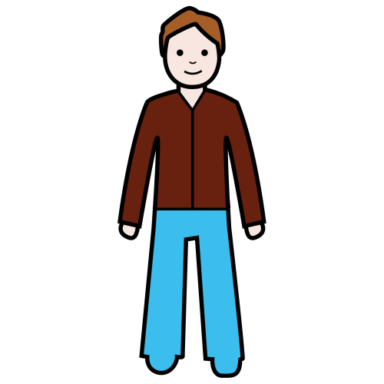
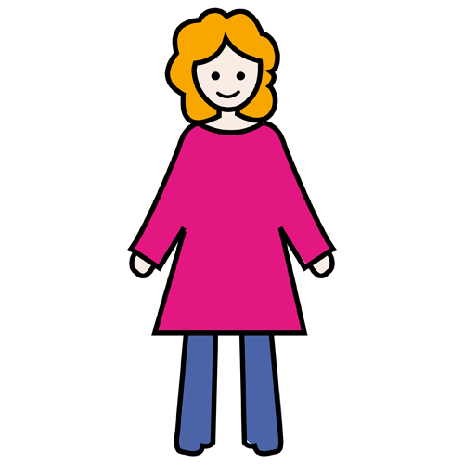

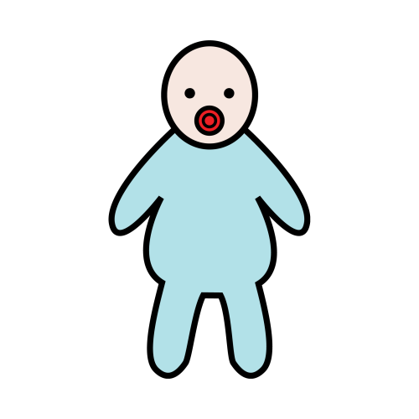






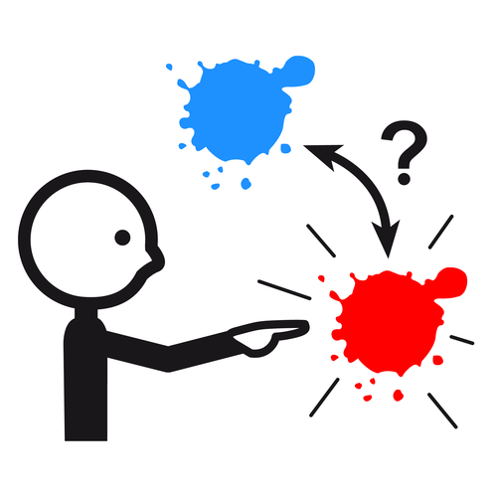

































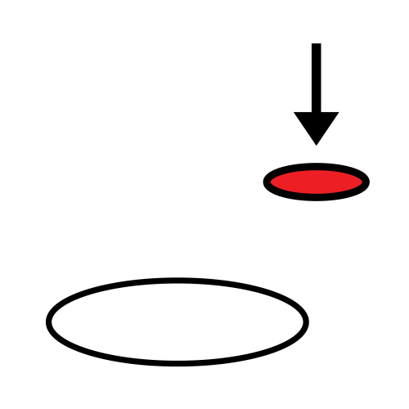










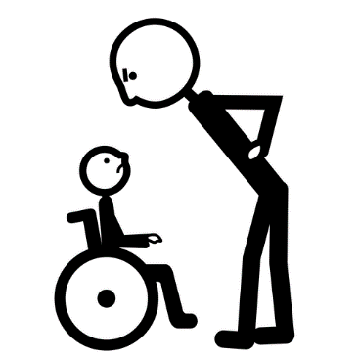





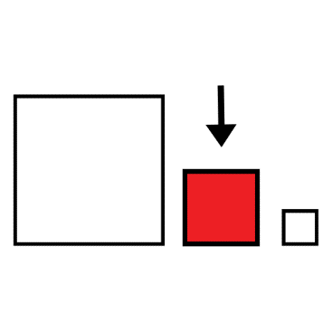














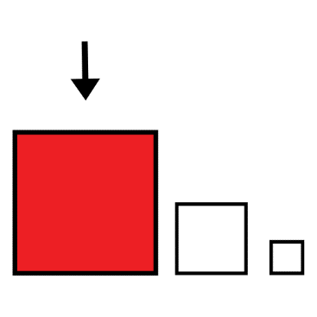








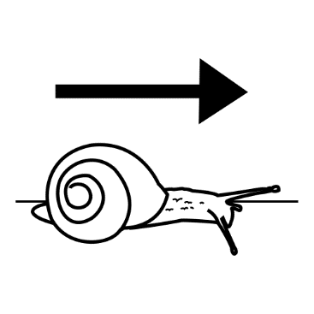




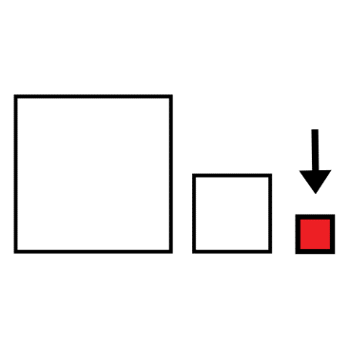


















































I / me
you
we/us
they/them
family
Mum
Dad
brother
sister
go away
cool
wait
problem
help
it
us
us
my/mine
his/hers
he/him
she
your(s)
friend
what
when
where
why
who
Edit
Edit
Edit
Edit
man
woman
child
baby
self
person
How much?
Can I ….?
which
really
maybe
Edit
Edit
Edit
Edit
all
this/that
fun
in
out
at
@
but
top
more
was/were
eat
drink
go
want/need
do/make
none
a
away
about
the
up/down
under/over
middle
can
are/be
look/see
/watch
ask/say/
tell/talk
stop
walk
read
some
to
from
with
and
is/am
here/there
bottom
on/off
because
come
give/get
think
take
turn
pretty
important
mean
Loud/quiet
colour
shape
wrong
right
medium
thirsty
like
listen
feel
put
need
nice
favorite
easy
fast
old
clean
long
dry
big
hungry
work
have
know
play
try
done/finish
idea
hard/difficult
slow
new
dirty
short
wet
little
safe
stand
count
find
hold
let
office
bedroom
garden
kitchen
bathroom
time
day
night
again
now
sit
win
buy
sing
open/close
outside
place
inside
place
community
place
shop
bank
yesterday
today
tomorrow
month
later
write
lose
wash/bath
/shower
change
fix
hospital
airport
bar/cafe
Food
Drinks
morning
afternoon
weekend
week
never
break
call
sleep
live
share

Slide 3

My name is
Hello
bye
How I communicate….
You can help me communicate by…..
yes
I’m fine
ok
I’m don’t feel well
No/not
I’m lost
I don’t know
I don’t understand
Can’t find what I need to say
don’t
I’m sorry
please
Thank you
excuse me
I want
to talk

